Slide 1
Pattern Recognition in Natural Science
by Christos Mavrikis & Bram van deR Venne

Slide 2
Content
Data
Value Proposition Canvas
Progress
EDA
PCA, Pre-processing, PARAFAC
Next Steps

Slide 3
Data
Experimented with different available data sets provided in the suggested links.
Decided to use –> Cream cheese data.
Data is rather well documented with two available sources to gain further insight.
Sensory Data – Sensory Analysis can be used for numerous reasons like : quality control, determining shelf life, gauging the readiness for product launch, assessing product success, flavor profiling, and identifying the attributes driving consumer.

Slide 4
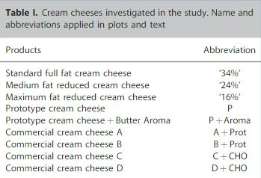
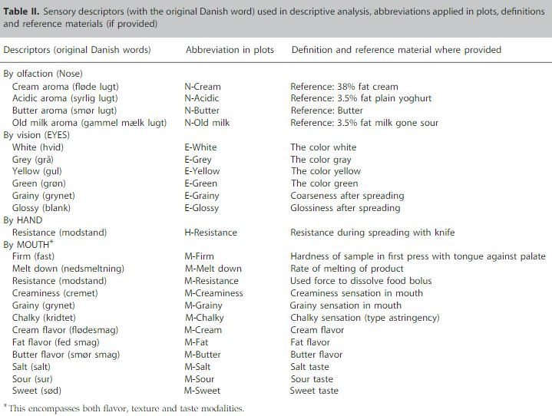
Data
1. Bro, Rasmus & Qannari, El Mostafa & Kiers, Henk & Næs, Tormod & Frøst, Michael. (2008). Multi‐way models for sensory profiling data. Journal of Chemometrics. 22. 36 - 45. 10.1002/cem.1097.

Slide 5
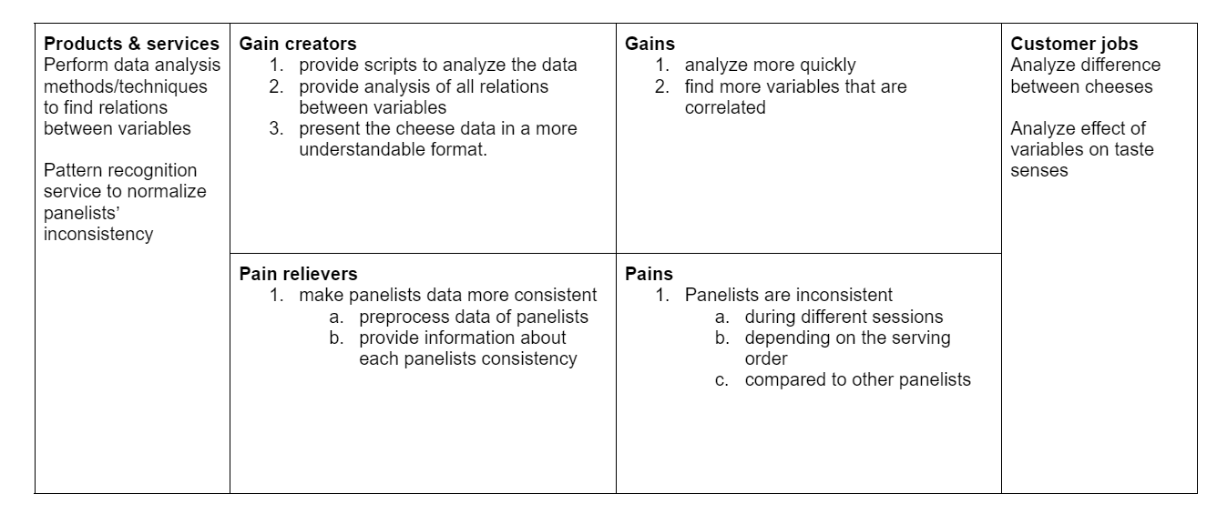
Value Proposition Canvas

Slide 6
Progress
Explored the data to further understand it and how to use it.
Created a value proposition canvas.
Performed EDA on data(mean & std over all data, mean & std over each panelist, class distribution).
Pre-processing: Using the functions available from the tutorial
PCA/Biplots: Altered the scripts from the tutorial to suit our data
PARAFAC: Tried to adapt some scripts from tutorial – not entirely successful yet
Plotted 4 different PCAs for raw data, normalized data, autoscaled data and autoscaled + normalized data.
Plotted 1 triplot after performing PARAFAC.

Slide 7
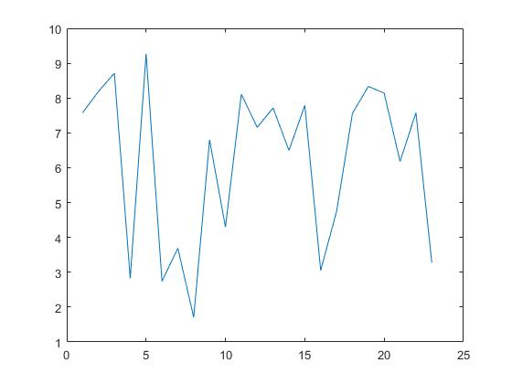
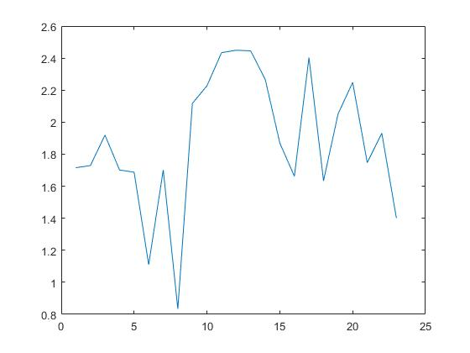
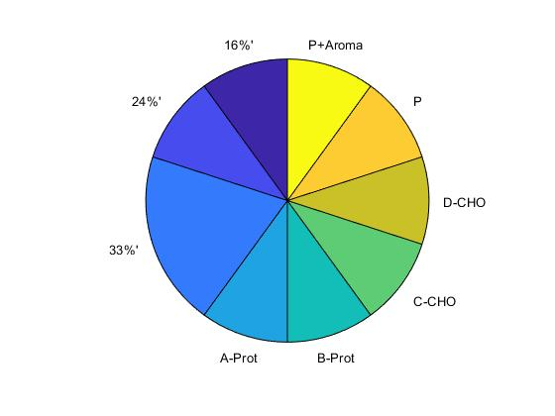
Exploratory Data Analysis
Standard Deviation
Class Distribution
Mean

Slide 8
Exploratory Data Analysis – Panelists Mean per Variable
Panelist | N-Cream | N-Acidic | N-Butter | N-Old Milk | E-White | E-Grey | E-Yellow | E-Green | H-Resistance | E-Grainy | E-shiny | M-Firm | M-Melt down | M-Resistance | M-Creaminess | M-Grainy | M-Chalky | M-Cream | M-Fat | M-Butter | M-Salt | M-Sour | M-Sweet
1 | 6.335 | 7.450 | 7.370 | 2.025 | 9.895 | 2.365 | 2.815 | 0.555 | 7.440 | 2.740 | 9.025 | 7.940 | 7.710 | 6.980 | 8.125 | 2.270 | 4.100 | 6.580 | 7.820 | 7.795 | 6.595 | 7.400 | 3.840
2 | 7.94 | 8.05 | 8.05 | 3.46 | 7.535 | 3.325 | 5.553 | 2.69 | 5.66 | 5.02 | 9.555 | 5.81 | 6.45 | 6.08 | 8.725 | 4.85 | 5.17 | 7.9 | 7.675 | 8.510 | 5.5 | 5.86 | 4.46
3 | 8.745 | 10.23 | 10.475 | 1.895 | 9.965 | 2.375 | 2.63 | 1.43 | 7.305 | 2.62 | 7.89 | 7.795 | 7.65 | 6.93 | 7.75 | 2.49 | 3.91 | 8.775 | 10.215 | 10.36 | 6.675 | 7.210 | 1.755
4 | 5.94 | 8.86 | 8.315 | 4.74 | 10.09 | 3.165 | 3.55 | 1.92 | 6.525 | 4.75 | 8.25 | 7.53 | 8.985 | 6.045 | 6.155 | 3.7 | 7.300 | 6.015 | 6.88 | 5.95 | 4.17 | 9.9 | 2.915
5 | 7.72 | 7.805 | 9.31 | 5.04 | 8.79 | 2.495 | 3.43 | 2.35 | 6.09 | 6.75 | 7.455 | 7.73 | 8.165 | 6.675 | 7.59 | 3.025 | 6.080 | 7.845 | 10.0 | 9.0 | 6.84 | 6.79 | 2.85
6 | 8.79 | 7.845 | 10.55 | 2.25 | 10.18 | 2.14 | 3.33 | 1.77 | 6.200 | 5.605 | 9.05 | 6.26 | 8.865 | 6.29 | 7.45 | 3.515 | 3.535 | 8.44 | 8.56 | 8.96 | 7.575 | 8.185 | 5.205
7 | 7.00 | 8.405 | 8.055 | 0.675 | 9.905 | 1.975 | 3.43 | 0.805 | 7.475 | 2.46 | 7.19 | 6.415 | 8.42 | 6.455 | 9.0450 | 1.14 | 3.91 | 8.135 | 8.3 | 7.975 | 5.8 | 8.67 | 2.46
8 | 7.90 | 6.535 | 7.255 | 2.36 | 8.29 | 4.02 | 4.68 | 1.99 | 7.525 | 4.2 | 6.14 | 7.6 | 5.13 | 6.365 | 7.215 | 3.333 | 3.78 | 6.53 | 6.76 | 6.245 | 5.165 | 6.325 | 2.64

Slide 9
Exploratory Data Analysis – Panelists Standard Deviation per Variable
Panelist | N-Cream | N-Acidic | N-Butter | N-Old Milk | E-White | E-Grey | E-Yellow | E-Green | H-Resistance | E-Grainy | E-shiny | M-Firm | M-Melt down | M-Resistance | M-Creaminess | M-Grainy | M-Chalky | M-Cream | M-Fat | M-Butter | M-Salt | M-Sour | M-Sweet
1 | 0.98 | 1.012 | 1.39 | 1.25 | 1.09 | 0.69 | 1.66 | 0.378 | 1.96 | 1.74 | 2.63 | 1.613 | 2.04 | 1.5 | 2.17 | 1.13 | 2.34 | 1.05 | 2.125 | 1.62 | 1.4 | 0.93 | 0.63
2 | 1.4 | 1.44 | 1.79 | 0.895 | 1.85 | 0.615 | 2.08 | 0.364 | 1.83 | 1.204 | 2.061 | 1.858 | 1.602 | 1.823 | 1.433 | 1.816 | 1.882 | 1.509 | 1.79 | 1.965 | 1.01 | 1.76 | 0.592
3 | 0.878 | 0.696 | 0.959 | 0.435 | 1.212 | 0.545 | 0.99 | 0.22 | 1.906 | 1.112 | 1.93 | 2.25 | 2.38 | 1.99 | 1.02 | 0.762 | 1.614 | 1.19 | 0.973 | 1.59 | 0.78 | 1.77 | 0.163
4 | 2.289 | 1.75 | 2.21 | 1.5455 | 1.662 | 0.9619 | 1.34 | 0.65 | 2.15 | 2.580 | 2.99 | 2.44 | 2.576 | 2.93 | 2.272 | 1.63 | 3.0 | 1.93 | 1.911 | 2.0 | 1.58 | 1.614 | 0.858
5 | 1.55 | 1.88 | 1.94 | 1.18 | 1.91 | 0.8 | 1.21 | 0.73 | 2.16 | 2.13 | 2.59 | 2.75 | 2.53 | 2.32 | 1.825 | 0.79 | 2.099 | 1.59 | 2.05 | 1.944 | 1.573 | 1.726 | 0.804
6 | 1.47 | 1.78 | 1.0 | 0.65 | 0.90 | 0.431 | 1.39 | 0.32 | 2.12 | 1.96 | 2.23 | 2.31 | 2.08 | 2.45 | 1.96 | 2.07 | 2.05 | 1.65 | 1.43 | 2.14 | 2.38 | 1.68 | 1.469
7 | 1.66 | 1.80 | 1.924 | 0.719 | 1.95 | 0.78 | 1.71 | 0.42 | 1.84 | 1.115 | 1.58 | 3.05 | 2.39 | 2.795 | 1.88 | 0.43 | 2.10 | 1.286 | 2.03 | 2.464 | 1.63 | 1.51 | 1.51
8 | 1.416 | 1.26 | 1.13 | 0.515 | 1.52 | 1.827 | 1.113 | 0.521 | 2.504 | 1.23 | 1.874 | 2.58 | 1.74 | 2.294 | 1.12 | 1.12 | 1.21 | 1.014 | 1.31 | 0.867 | 0.78 | 1.459 | 0.69

Slide 10
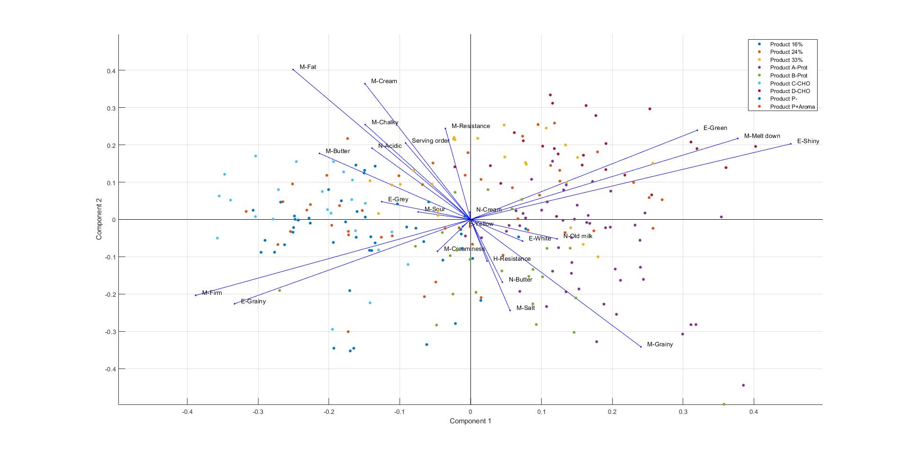
PCA – Raw Data

Slide 11
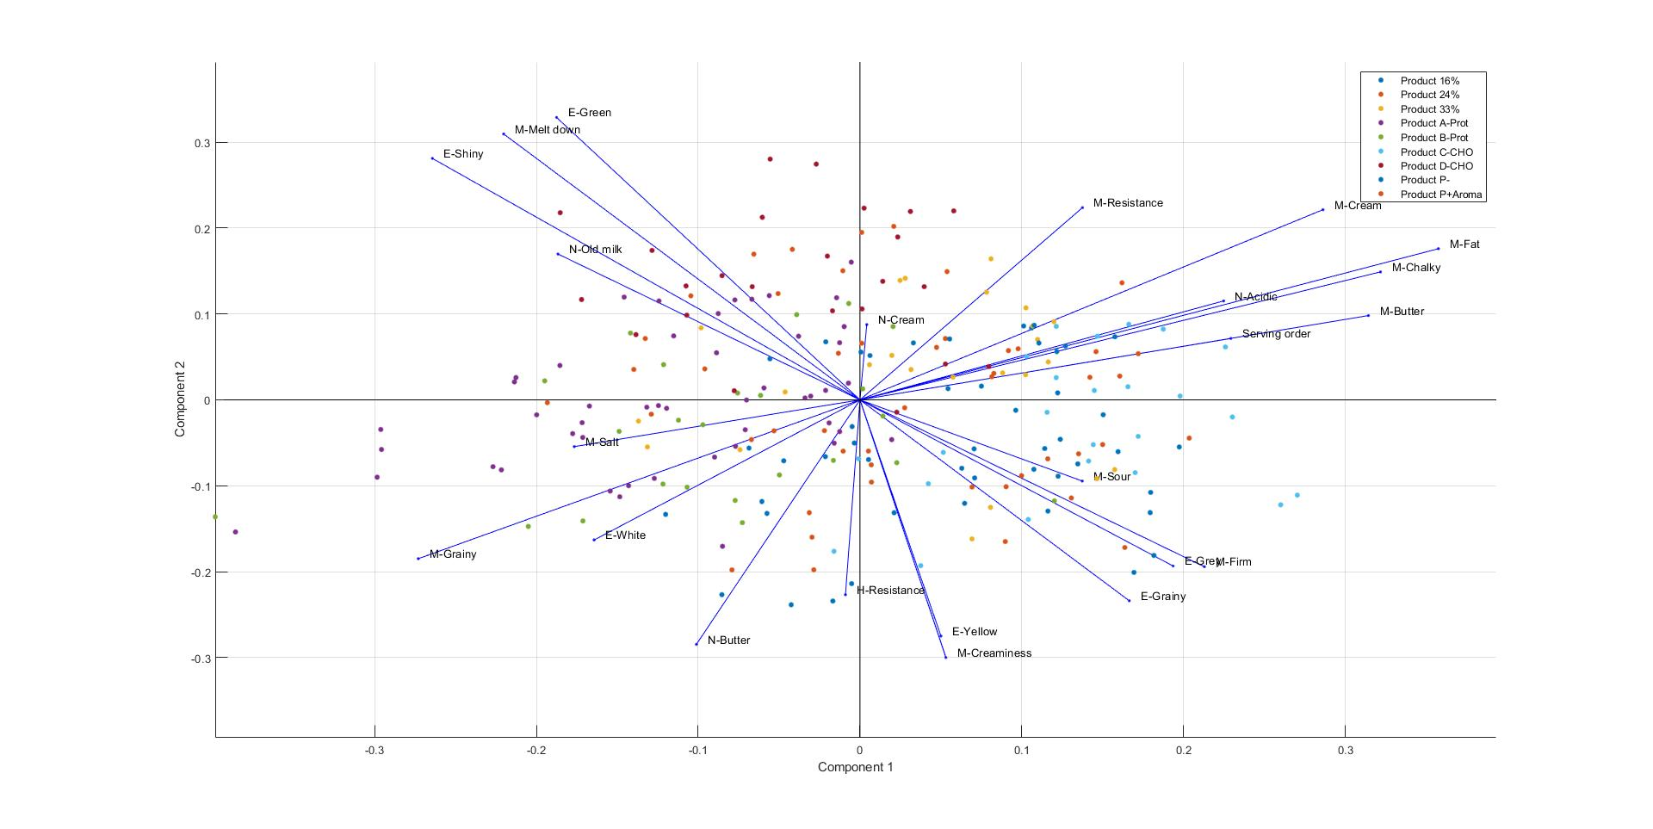
PCA – Autoscaled Data

Slide 12
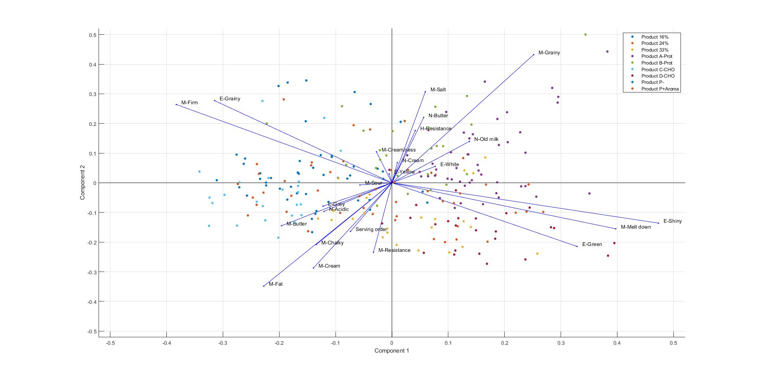
PCA – Normalized Data

Slide 13
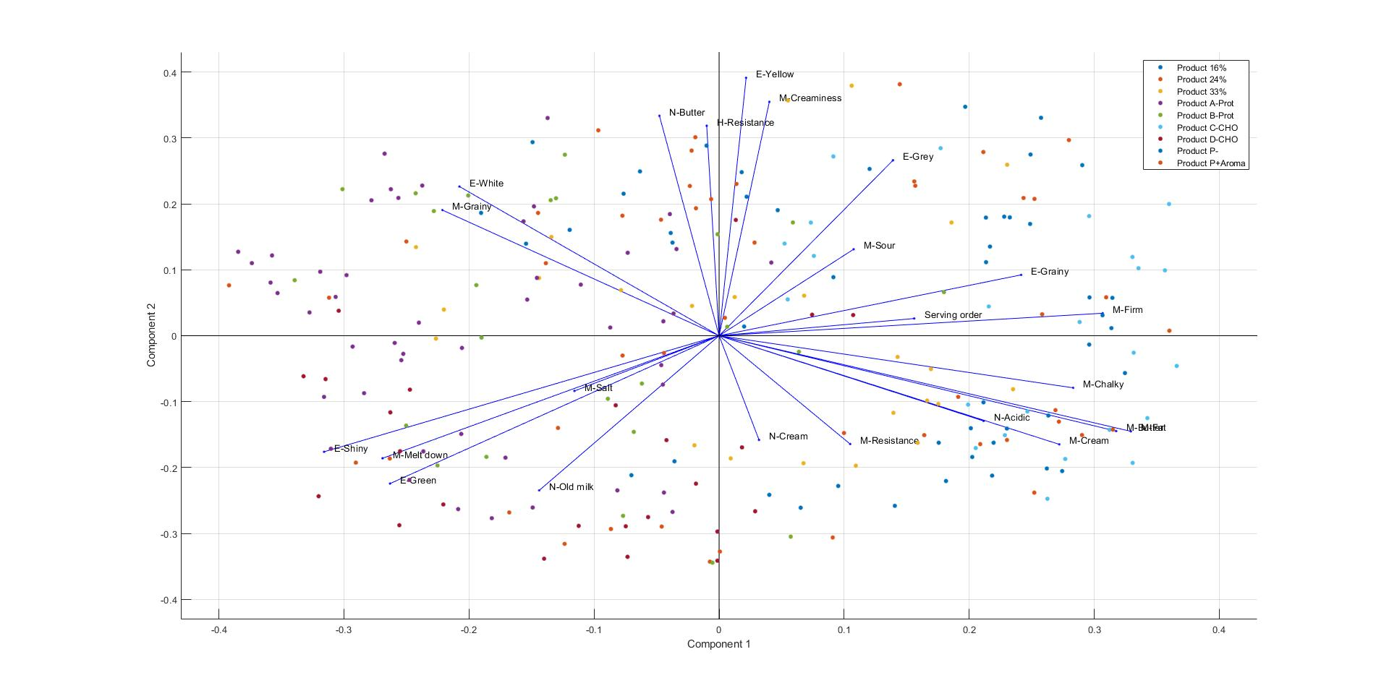
PCA – Autoscaled + Normalized Data

Slide 14
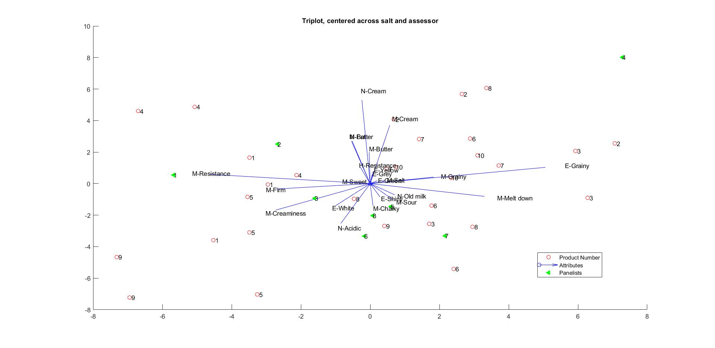
PARAFAC – Triplot

Slide 15
Next steps
Adapt PARAFAC to our data
Perform PLS-R or PLS-DA
Calculate mean/std per panelist per product and not only collectively
Verify if pre-processing is actually beneficial for this data
Verify if everything we have done up until now is actually correct

Slide 16

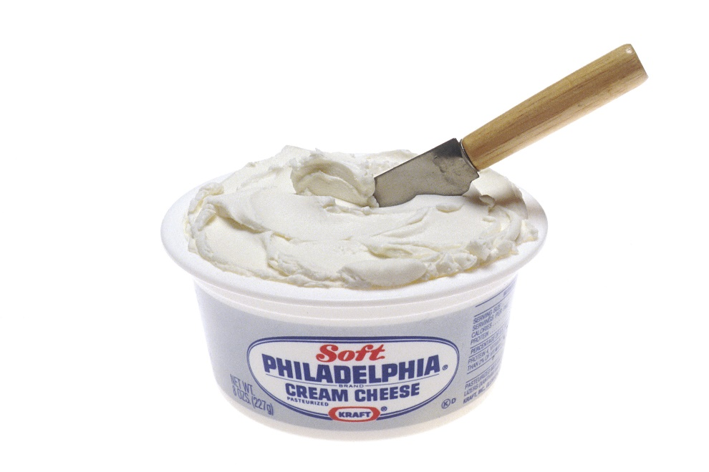
The End

